Slide 1

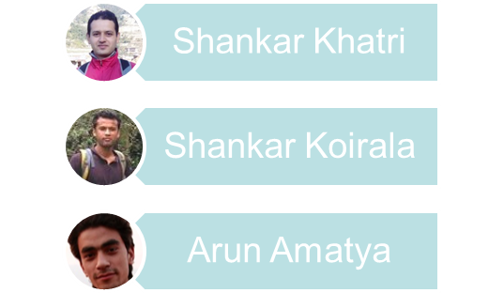
Presented By:-

Slide 2
Cohesion
Definition: The degree to which all elements of a component are directed towards a single task and all elements directed towards that task are contained in a single component.
Internal glue with which component is constructed
All elements of component are directed toward and essential for performing the same task
High is good

Slide 3
Range of Cohesion
High Cohesion
Functional
Informational
Sequential
Communicational
Procedural
Temporal
Logical
Coincidental
Low

Slide 4
Coincidental Cohesion
Definition: Parts of the component are only related by their location in source code
Elements needed to achieve some functionality are scattered throughout the system.
Accidental
Worst form

Slide 5
Example
Print next line
Reverse string of characters in second argument
Add 7 to 5th argument
Convert 4th argument to float
Notes:
I don’t even want to think about it.

Slide 6
Logical Cohesion
Definition: Elements of component are related logically and not functionally.
Several logically related elements are in the same component and one of the elements is selected by the client component.

Slide 7
Example-1
A component reads inputs from tape, disk, and network. All the code for these functions are in the same component.
Operations are related, but the functions are significantly different.
Notes:
I don’t even want to think about it.

Slide 8
Example-2
A component reads inputs from tape, disk, and network. All the code for these functions are in the same component. Operations are related, but the functions are significantly different.
Improvement
A device component has a read operation that is overridden by sub-class components. The tape sub-class reads from tape. The disk sub-class reads from disk. The network sub-class reads from the network.
Notes:
I don’t even want to think about it.

Slide 9
Temporal Cohesion
Definition: Elements of a component are related by timing.
Difficult to change because you may have to look at numerous components when a change in a data structure is made.
Increases chances of regression fault
Component unlikely to be reusable.

Slide 10
Example-1
A system initialization routine: this routine contains all of the code for initializing all of the parts of the system. Lots of different activities occur, all at init time.
Notes:
I don’t even want to think about it.

Slide 11
Example-2
A system initialization routine: this routine contains all of the code for initializing all of the parts of the system. Lots of different activities occur, all at init time.
Improvement
A system initialization routine sends an initialization message to each component.
Each component initializes itself at component instantiation time.
Notes:
I don’t even want to think about it.

Slide 12
Procedural Cohesion
Definition: Elements of a component are related only to ensure a particular order of execution.
Actions are still weakly connected and unlikely to be reusable

Slide 13
Example
...
Read part number from data base
update repair record on maintenance file.
...
May be useful to abstract the intent of this sequence. Make the data base and repair record components handle reading and updating. Make component that handles more abstract operation.

Slide 14
Communicational Cohesion
Definition: Module performs a series of actions related by a sequence of steps to be followed by the product and all actions are performed on the same data

Slide 15
Example
Update record in data base and send it to the printer.
database.Update (record).
record.Print().
Notes:
I don’t even want to think about it.

Slide 16
Sequential Cohesion
The output of one component is the input to another.
Occurs naturally in functional programming languages
Good situation

Slide 17
Informational Cohesion
Definition: Module performs a number of actions, each with its own entry point, with independent code for each action, all performed on the same data.
Different from logical cohesion
  Each piece of code has single entry and single exit
  In logical cohesion, actions of module intertwined
ADT and object-oriented paradigm promote

Slide 18
Functional Cohesion
Definition: Every essential element to a single computation is contained in the component.
Every element in the component is essential to the computation.
Ideal situation.

Slide 19
Examples of Cohesion-1
Function A
Function A
Function A’
Function A’’
Time t₀
Time t₀ + X
Time t₀ + 2X
Function
B
Function
C
logic
Function
D
Function
E
Coincidental
Parts unrelated
Logical
Similar functions
Temporal
Related by time
Function A
Function B
Function C
Procedural
Related by order of functions

Slide 20
Examples of Cohesion-2
Function A
Function B
Function C
Function A
Function B
Function C
Communicational
Access same data
Sequential
Output of one is input to another
Function A part 1
Function A part 2
Function A part 3
Functional
Sequential with complete, related functions

Slide 21


